Slide 1


How many emails do you think are sent in a day worldwide?
Notes:
https://time.com/6108001/data-protection-richard-stengel/

Slide 2
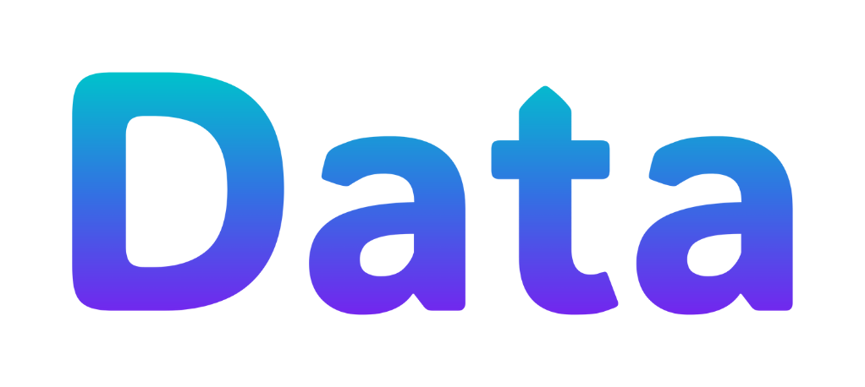
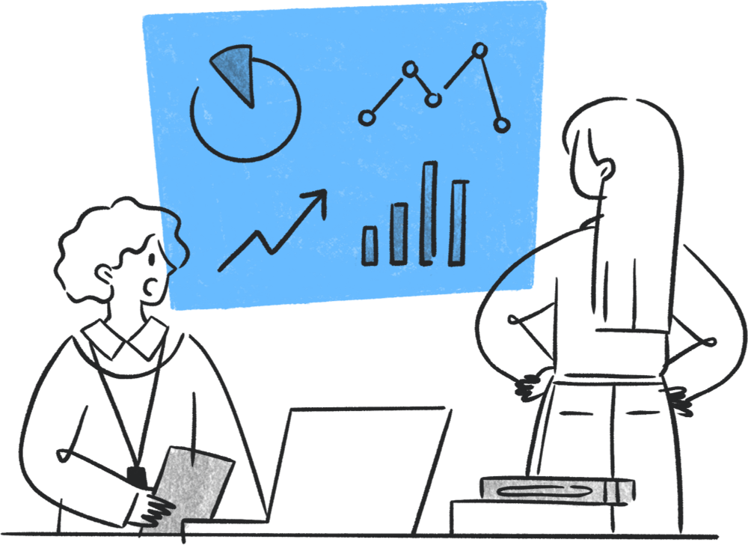

Slide 3
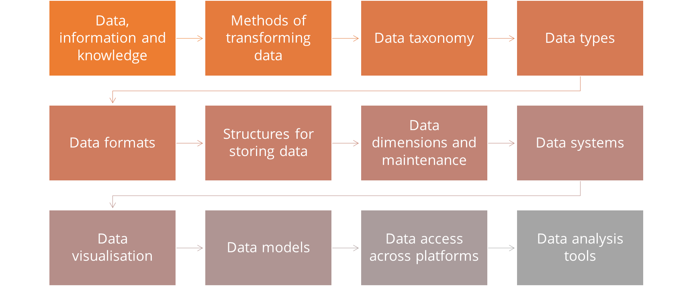

Slide 4
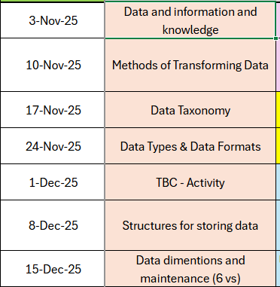
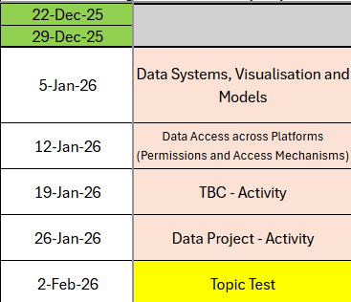

Slide 5
You’re Amazon’s AI recommendation system for the day.
A customer just bought a Nintendo Switch.
What three things might you recommend next — and why?

Slide 6
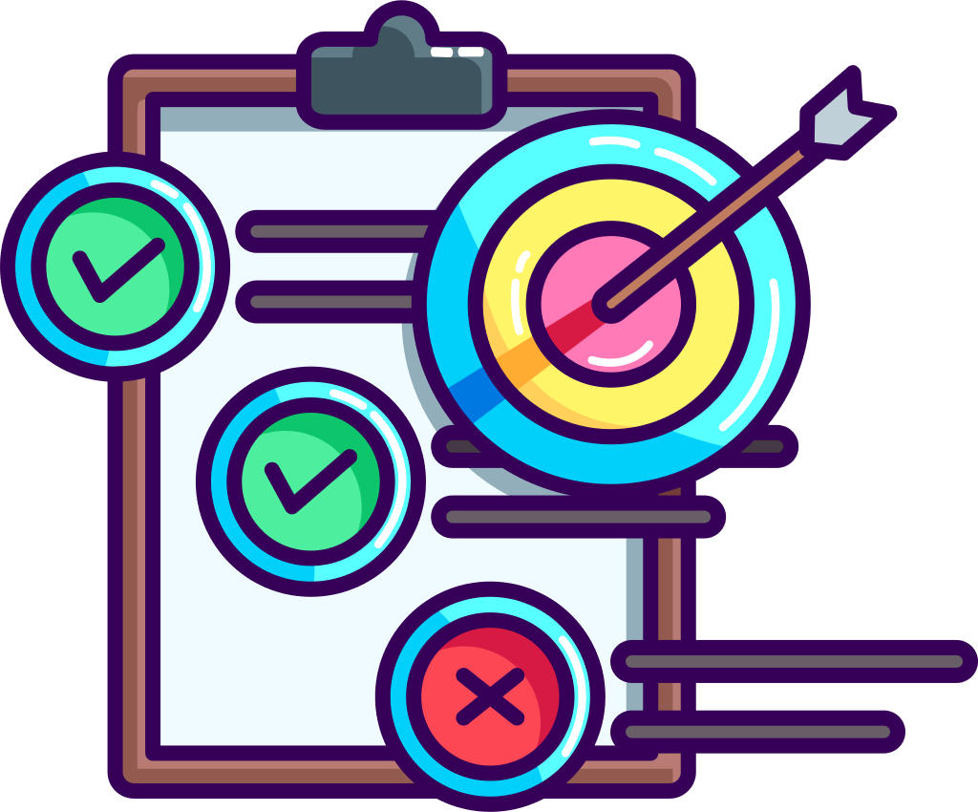
Learning Objectives
-Define data, information and knowledge, and explain how they link together
-Describe how data is generated by people and digital systems
-Explain how organisations use data to meet business needs and identify benefits and challenges of digital technologies in doing so

Slide 7

Data, Information and Knowledge

Slide 8
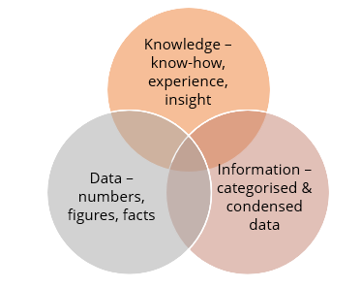
Notes:
Data is the raw material of information, typically numeric.
Information is data which is collected together with commentary, context and analysis so it's meaningful to others.
Knowledge is a combination of information and a person's experience, intuition and expertise.
Further reading: https://knowledge-management-tools.net/knowledge-information-data

Slide 9
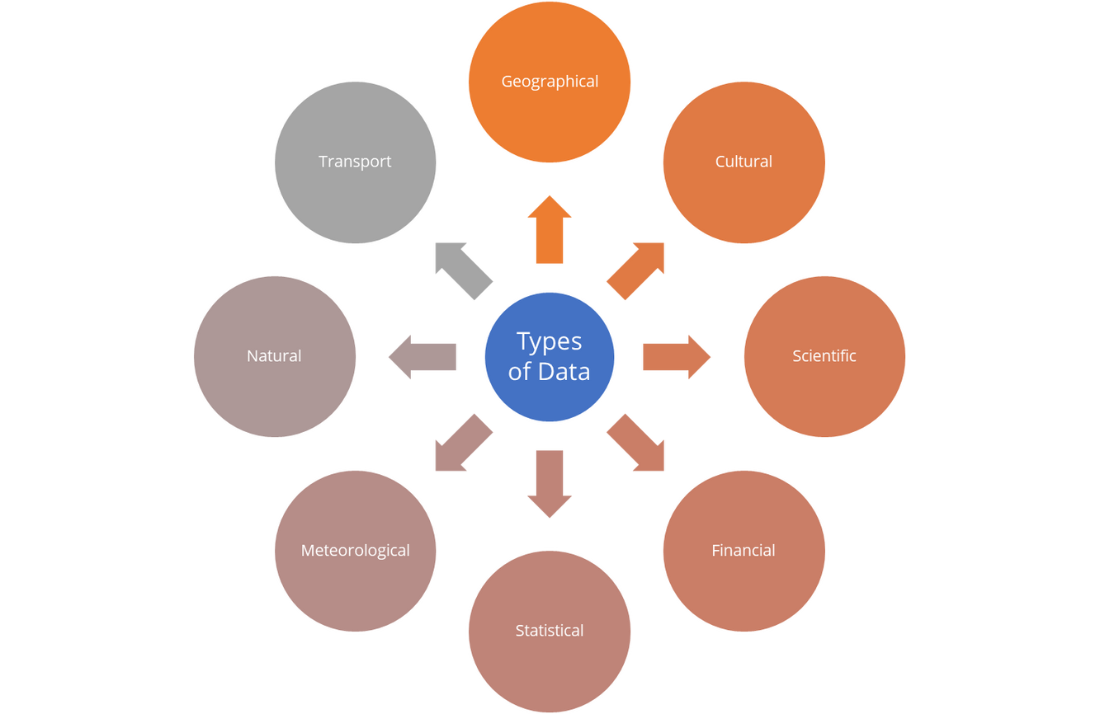
What is data?
In computing, data is information that has been translated into a format that is efficient for movement of processing.
Relative to today’s computers and transmission media, data is information converted into binary digital form
Notes:
Data is any set of characters that is gathered and translated for a purpose, usually analysis. If data is not put into context, it doesn't have any impact for a person or PC.
Common data types include:
Single character
Boolean (true or false)
Text (string)
Number (integer or floating-point)
Picture
Sound
Video
Further reading: https://www.mathsisfun.com/data/data.html

Slide 10
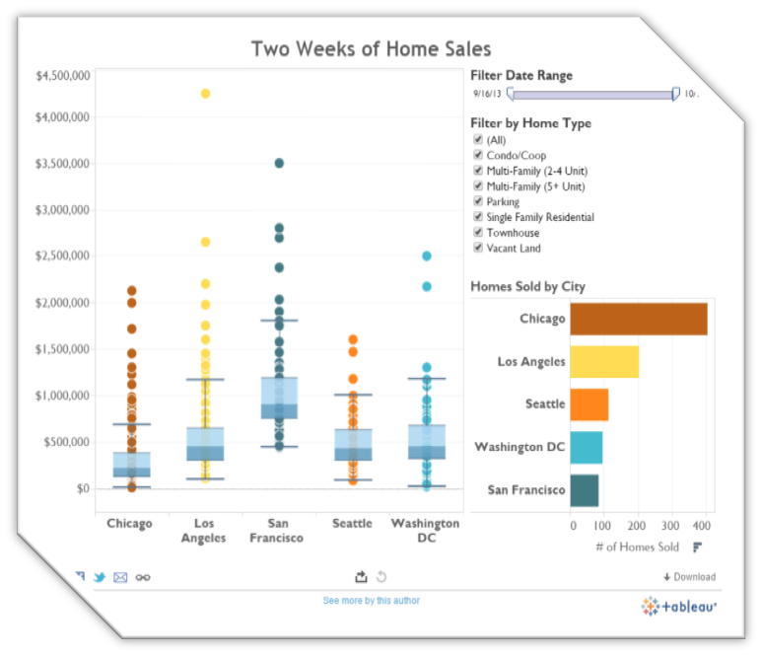
What is information?
Information is organised or class co-ordinated value, which has some meaningful values for the receiving person.
Information is fully processed data on which decisions and actions can be taken
Notes:
Information is data that has been processed so it's meaningful to the person receiving it - anything communicated and processed.
Data can be the name of a person, place, number etc.
Further reading: https://www.diffen.com/difference/Data_vs_Information

Slide 11
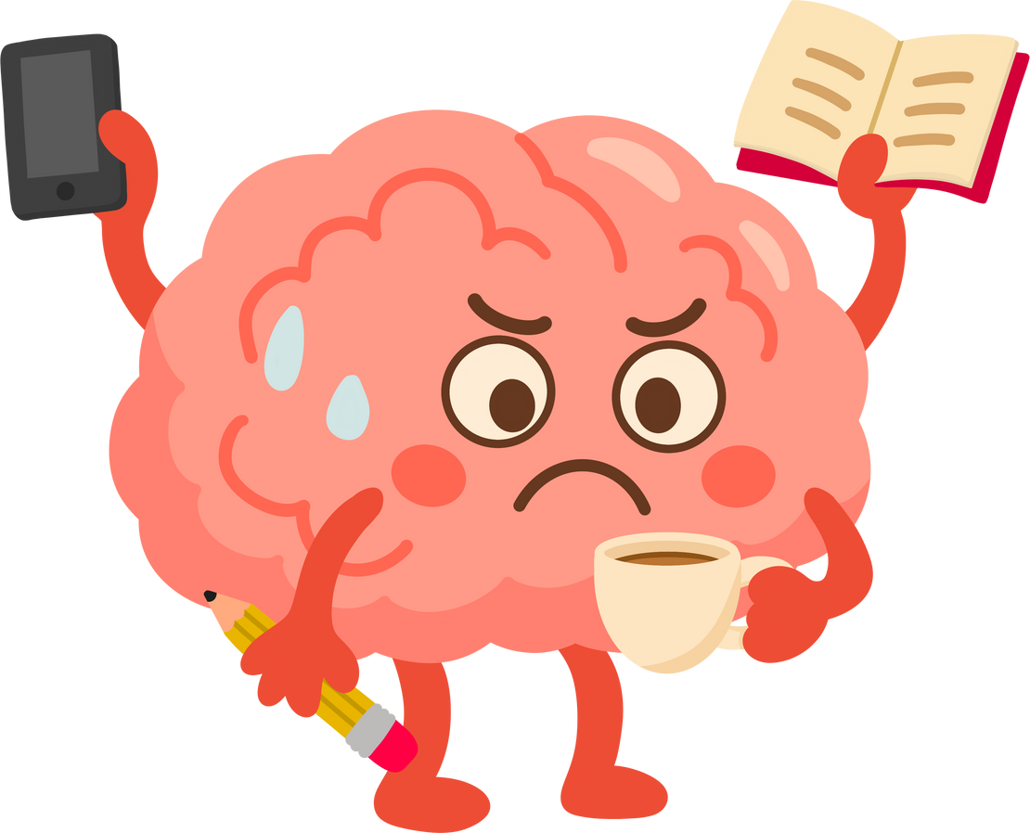
What is knowledge?
Knowledge is defined as what is learned, understood, or aware of
An example of knowledge is
-Learning the alphabet
-Having the ability to find a location
-Remembering details about an event
Notes:
Further reading:
https://www.ontotext.com/knowledgehub/fundamentals/dikw-pyramid/
https://www.psychologytoday.com/gb/blog/theory-knowledge/201312/what-is-knowledge-brief-primer

Slide 12

Activity
Write your own definitions for
-Knowledge
-Information
-Data
Provide some examples of the above from the digital sector
Notes:
Further reading:
https://www.ontotext.com/knowledgehub/fundamentals/dikw-pyramid/
https://www.psychologytoday.com/gb/blog/theory-knowledge/201312/what-is-knowledge-brief-primer

Slide 13

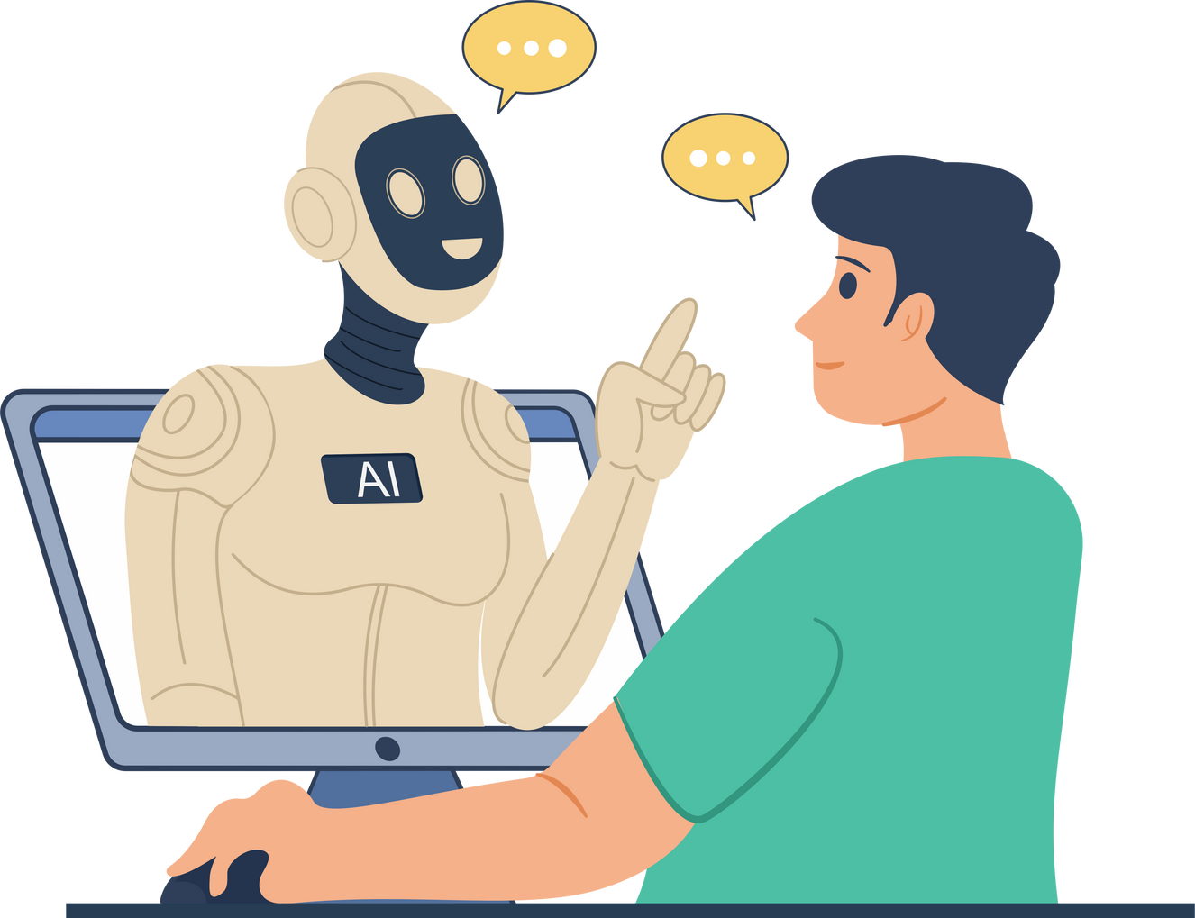

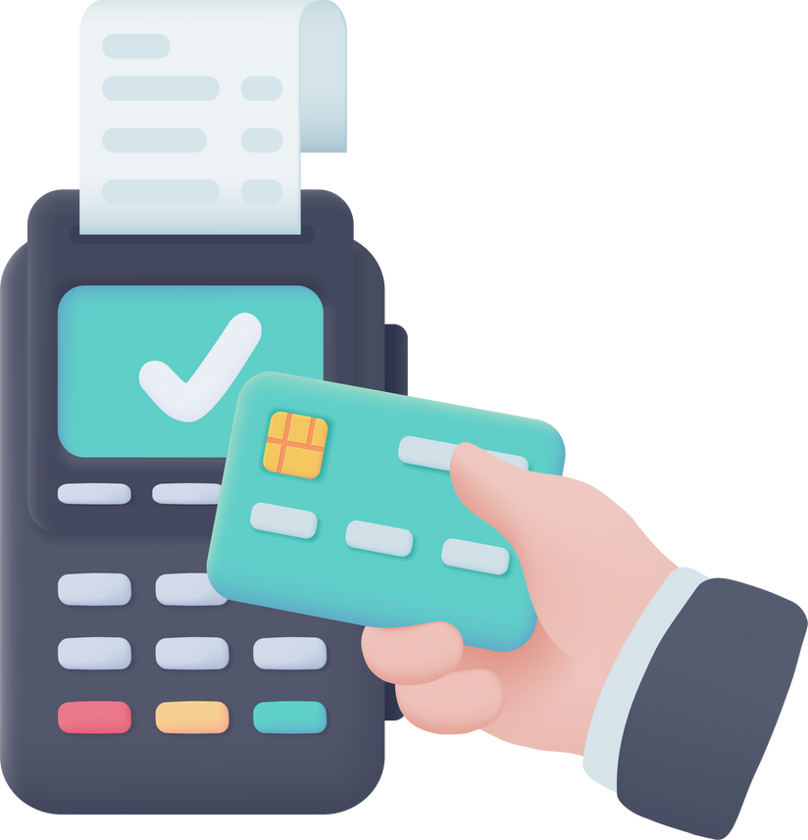

What ways do we generate data?
Human
AI
Sensors
IOT
Transactions
Notes:
Further reading: https://www.futurelearn.com/info/courses/data-analytics-python-statistics-and-analytics fundamentals/0/steps/186574

Slide 14

Notes:
Think about the amount of data we generate and how this is specific for the industry elements in the video

Slide 15
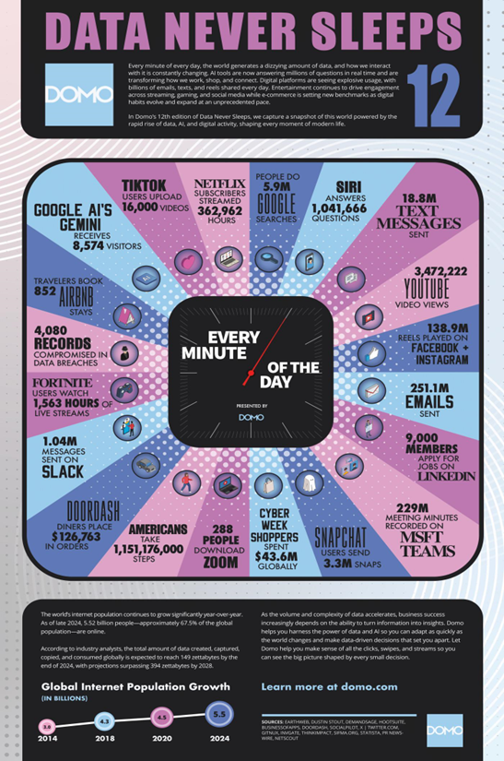
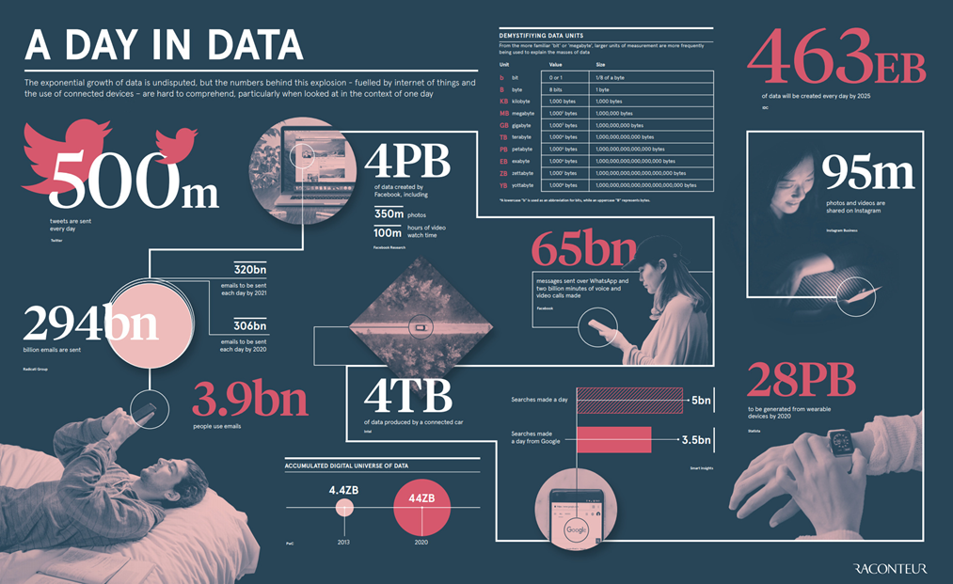
Notes:
Further reading: https://spacelift.io/blog/how-much-data-is-generated-every-day
https://bernardmarr.com/how-much-data-do-we-create-every-day-the-mind-blowing-stats-everyone-should-read/
Internet: 40,000 internet searches every second- 5 billion a day
Social Media: Snapchat share 527,760 photos a day, 46,740 photos are posted on instagram
Communication: 16 million texts a minute, 156 million emails
Spotify: 13 songs a minute
IOT:

Slide 16
Activity 1
Research the five different data sources used by organisations:
What is this type of data source?
How does it generate or collect data?
Give one real-world example (e.g. smart watch sensors, retail transactions, AI chatbots).
What is one benefit and one challenge of using this data source?
Notes:
Further reading: https://www.futurelearn.com/info/courses/data-analytics-python-statistics-and-analytics fundamentals/0/steps/186574
Research the different types of data each of these may

Slide 17
Discussion
Human
AI
Sensors
IOT
Transactions
Notes:
Further reading: https://www.futurelearn.com/info/courses/data-analytics-python-statistics-and-analytics fundamentals/0/steps/186574
Research the different types of data each of these may

Slide 18
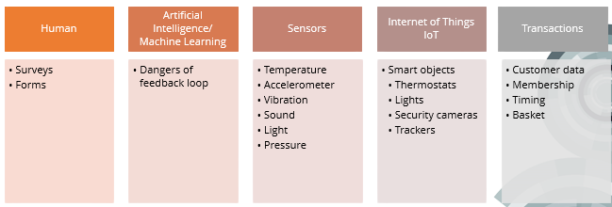
Notes:
Further reading: https://www.futurelearn.com/info/courses/data-analytics-python-statistics-and-analytics fundamentals/0/steps/186574
Research the different types of data each of these may

Slide 19

Human - Forms and Surveys
Surveys are designed to collect opinions and feedback from people. They are an efficient way to gather large amounts of information from people to inform decision making
Forms are designed to gather specific information from people such as personal information, confidential etc. Forms tend to be used for registrations, contact details etfc.
Notes:
Further reading: https://www.zonkafeedback.com/blog/data-collection-forms
What sources might you collect on a survey, what ones on a form, and which might appear on both?

Slide 20

Artificial intelligence/Machine Learning
AI uses complex algorithms to inform decision making Machine learning is the branch of AI that uses algorithms to learn from data that has been provided.
Feedback loops allow AI to continuously learn and improve. This can present challenges as the more AI content there is, the more chance AI can include it’s own output
Notes:
Further reading: https://www.ibm.com/think/insights/10-ai-dangers-and-risks-and-how-to-manage-them

Slide 21
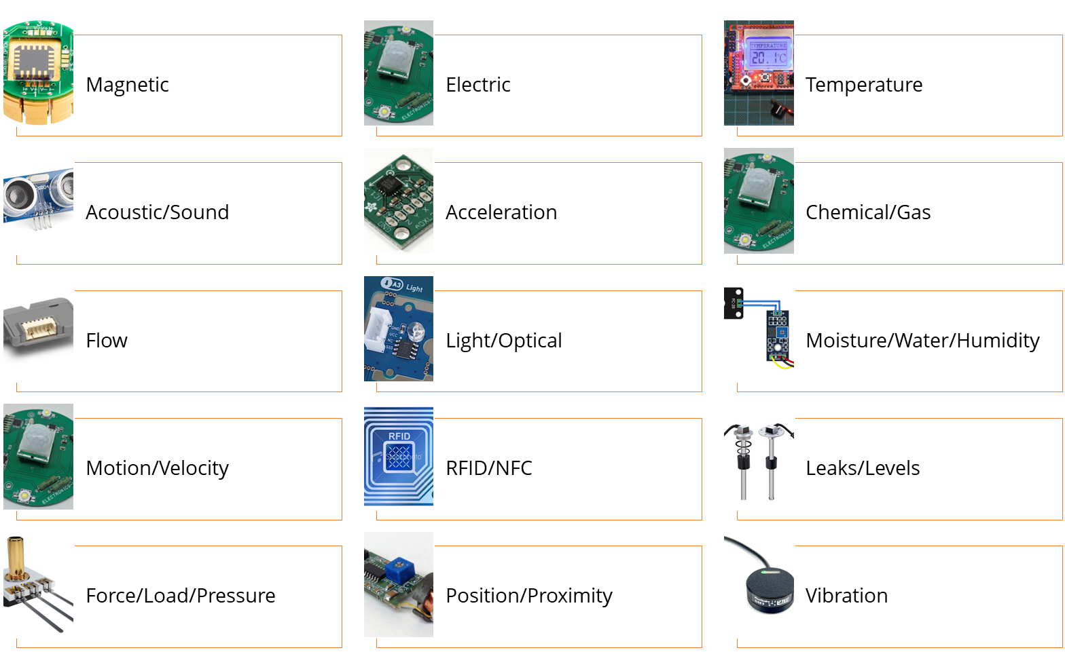
Sensors and Internet of Things
Notes:
Sensors are devices that detect and respond to changes they are designed to detect. Some sensors stand alone but most connect to IoT as the information they gather from interconnected devices allow IoT systems to use and understand data.
Further reading: https://www.techtarget.com/whatis/definition/sensor
https://www.youtube.com/watch?v=6YaXKxXSli0&t=31s

Slide 22
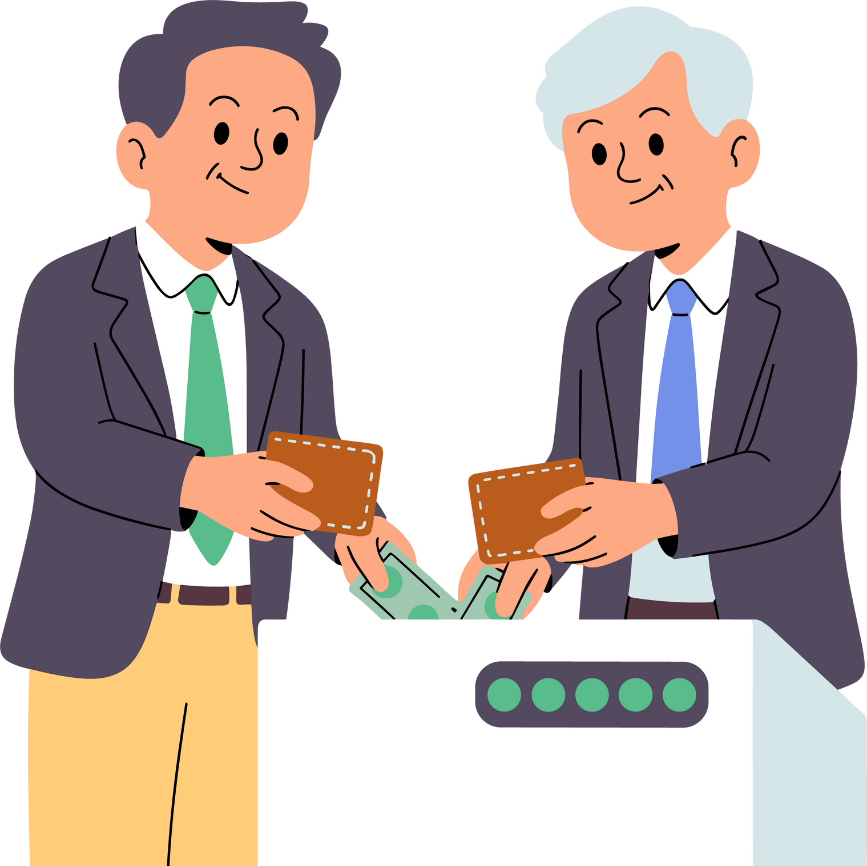
Transactions
Customer data such as memberships, purchases, loyalty apps etc.
Notes:
Further reading:
https://www.tibco.com/glossary/what-is-transactional-data

Slide 23
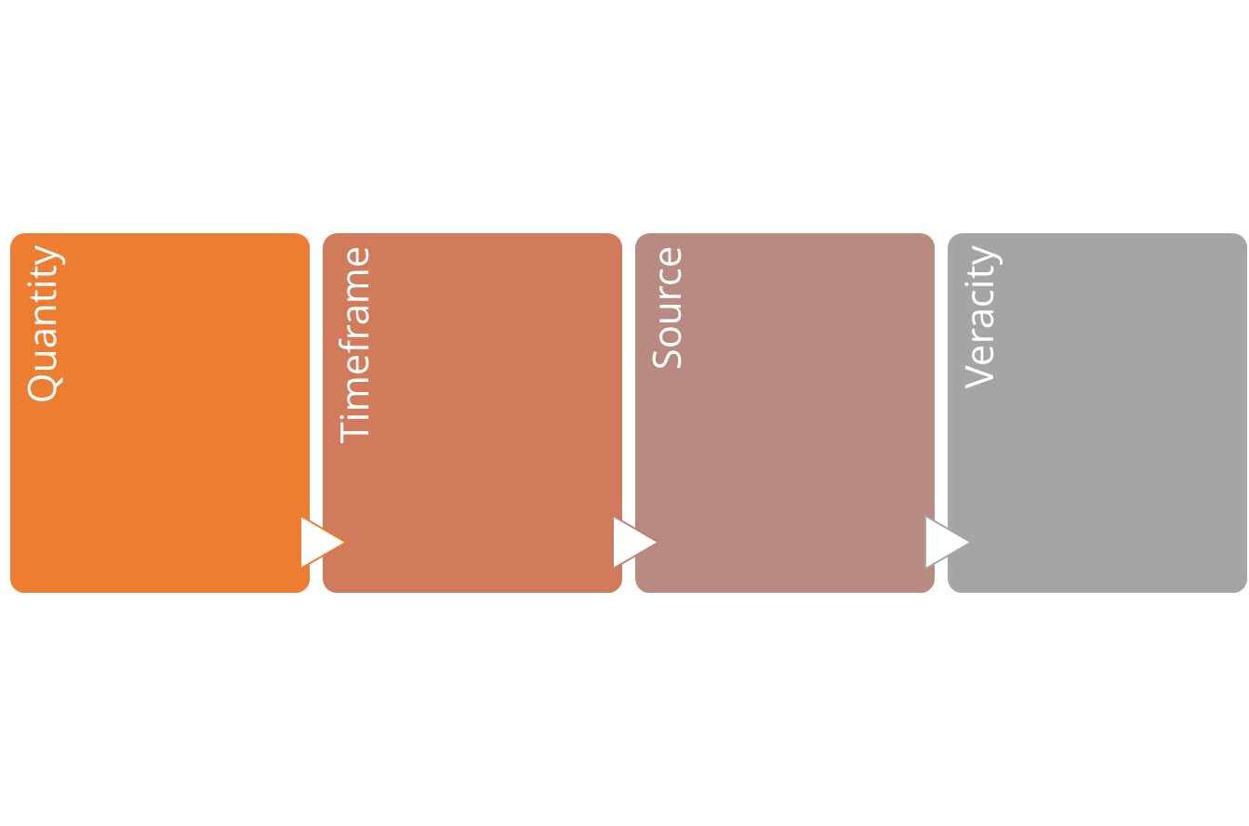
How do we measure the value of data?
Notes:
GDPR
Data Protection
Further reading: https://www.youtube.com/watch?v=kbjXwUnc0I0&t=95s
https://www.iso.org/artificial-intelligence/responsible-ai-ethics

Slide 24

Quantity
Is the quantity of data that has been gathered sufficient to reflect the wider population?
Is the quantity of data collected too small to make informed decisions from?
Notes:
GDPR
Data Protection
Further reading: https://www.youtube.com/watch?v=kbjXwUnc0I0&t=95s
https://www.iso.org/artificial-intelligence/responsible-ai-ethics

Slide 25

Timeframe
When was the data gathered and over how long?
Is the data recent or older?
What is gathered over stable or unique circumstances?
Was there sufficient time to gather the data?
Notes:
GDPR
Data Protection
Further reading: https://www.youtube.com/watch?v=kbjXwUnc0I0&t=95s
https://www.iso.org/artificial-intelligence/responsible-ai-ethics

Slide 26

Source
Is the source of the data reliable?
Can we confirm it as primary research?
If secondary, is it trusted?
Can we verify the data?
Notes:
GDPR
Data Protection
Further reading: https://www.youtube.com/watch?v=kbjXwUnc0I0&t=95s
https://www.iso.org/artificial-intelligence/responsible-ai-ethics

Slide 27

Veracity
Is the data that’s been gathered accurate?
Is it truthful?
Is it trustworthy?
Notes:
GDPR
Data Protection
Further reading: https://www.youtube.com/watch?v=kbjXwUnc0I0&t=95s
https://www.iso.org/artificial-intelligence/responsible-ai-ethics

Slide 28
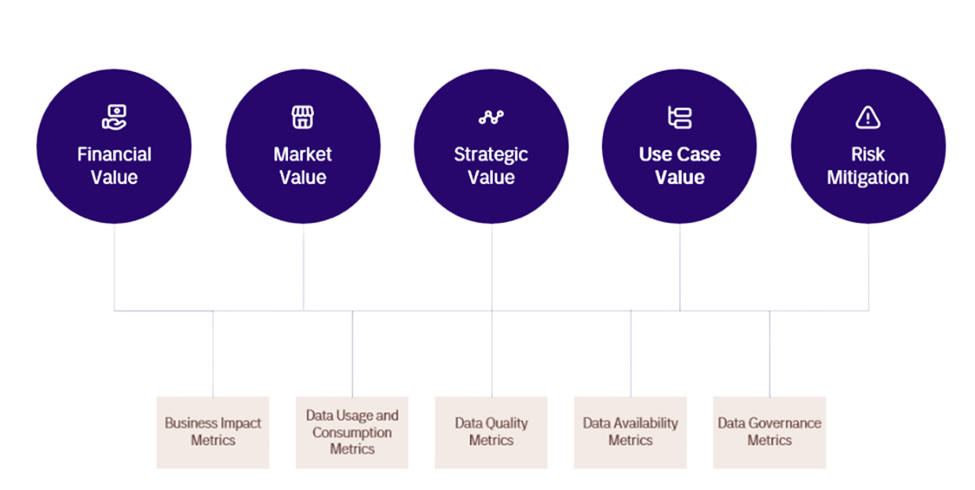
Further Value
Notes:
GDPR
Data Protection
Further reading: https://www.youtube.com/watch?v=kbjXwUnc0I0&t=95s
https://www.iso.org/artificial-intelligence/responsible-ai-ethics

Slide 29
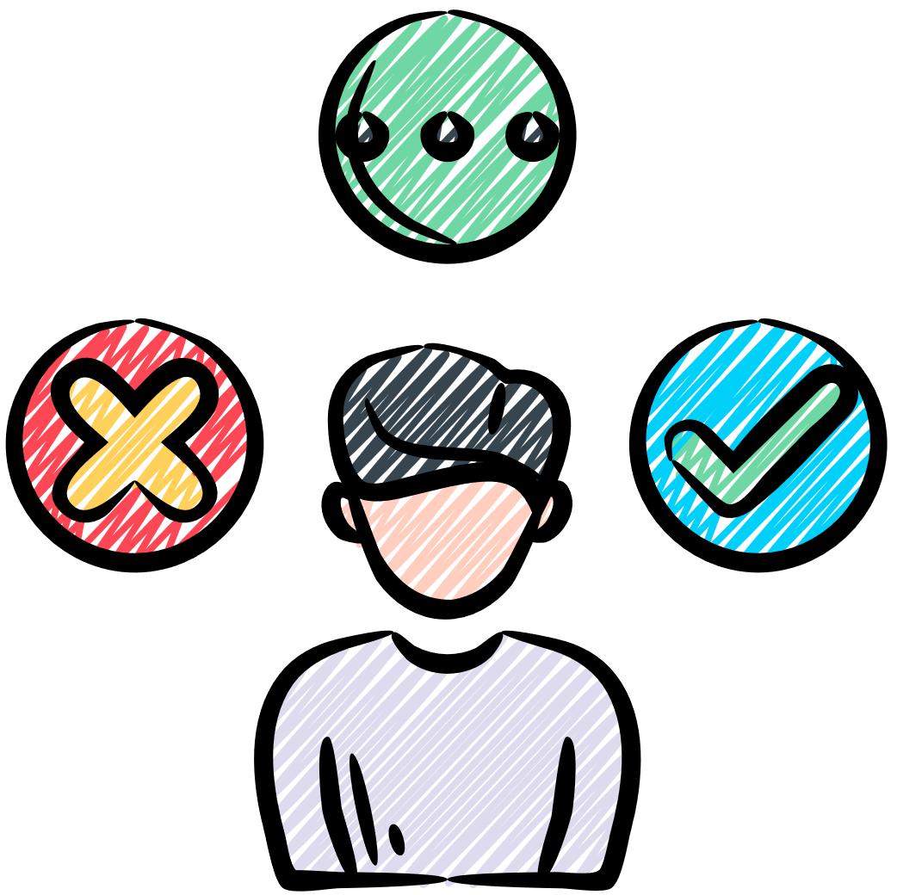
Ethical data practices
What legislation might be in place to ensure UK businesses adhere to ethical data practices?
Notes:
GDPR
Data Protection
Further reading: https://www.youtube.com/watch?v=kbjXwUnc0I0&t=95s
https://www.iso.org/artificial-intelligence/responsible-ai-ethics

Slide 30
Is the data collection necessary for the stated purpose?
Is consent clear, specific, and revocable?
Who else will see this data (vendors, partners, buyers)?
Is the data stored securely and only as long as needed?
Could this use cause harm or unequal outcomes for particular groups?
Are there documented policies, audits, and a named person responsible?
Notes:
GDPR
Data Protection
Further reading: https://www.youtube.com/watch?v=kbjXwUnc0I0&t=95s
https://www.iso.org/artificial-intelligence/responsible-ai-ethics

Slide 31
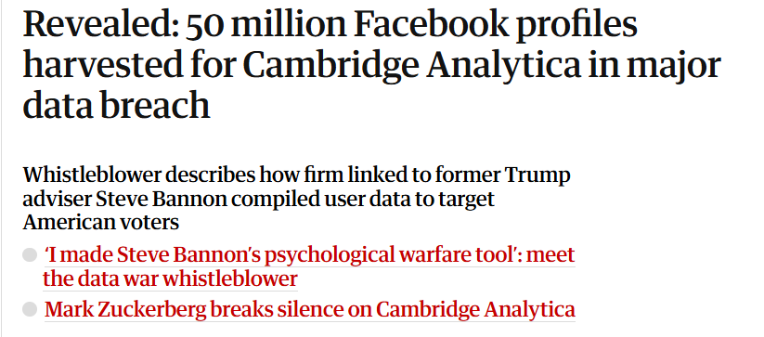
When does it go wrong?
Notes:
Further Reading: https://www.theguardian.com/news/2018/mar/17/cambridge-analytica-facebook-influence-us-election

Slide 32
Tiktok research - Activity 2 /3
TikTok is one of the most popular social media apps in the world.
Like many apps, it collects data such as your likes, watch history, and device information.
TikTok says it uses this data to make your feed more personal, show relevant ads, and keep users safe.
However, some experts and governments have raised concerns about where the data is stored, who can access it, and how clearly TikTok explains its privacy settings.
The goal of this activity is to understand how data like this is used — and how you can make informed decisions online.
Notes:
All services we use collect data

Slide 33
Tinker
Open an app on your phone, and find the privacy and safety settings
Identify what options exists i.e. data downloads, personalisation
Note one positive and one improvement idea
Notes:
GDPR
Data Protection
Further reading: https://www.youtube.com/watch?v=kbjXwUnc0I0&t=95s
https://www.iso.org/artificial-intelligence/responsible-ai-ethics

Slide 34

Reflection
What surprised you the most about how businesses use data?
Notes:
GDPR
Data Protection
Further reading: https://www.youtube.com/watch?v=kbjXwUnc0I0&t=95s
https://www.iso.org/artificial-intelligence/responsible-ai-ethics

Slide 35
Learning Objectives
-Define data, information and knowledge, and explain how they link together
-Describe how data is generated by people and digital systems
-Describe the ethics to consider when collecting data for business purposes

